Slide 1
Registering And Joining Developer Program
Sisoft Technologies Pvt Ltd
SRC E7, Shipra Riviera Bazar, Gyan Khand-3, Indirapuram, Ghaziabad
Website: www.sisoft.in Email:info@sisoft.in
Phone: +91-9999-283-283

Slide 2
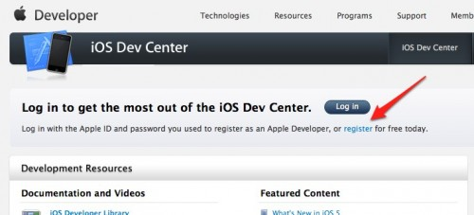
Register yourSelf
If you don’t yet have an Apple developer account, go to the iOS Dev Center and click the “register” link

Slide 3
Click On “Get Started”

Slide 4
Go And select “Create an Apple ID” and click “Continue

Slide 5
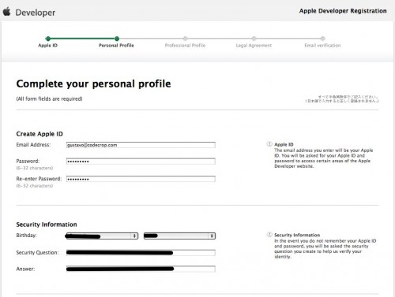
Fill in your email, password and security information Carefully

Slide 6
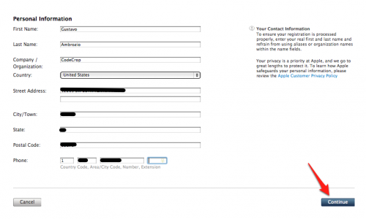
fill out your personal information and click continue

Slide 7
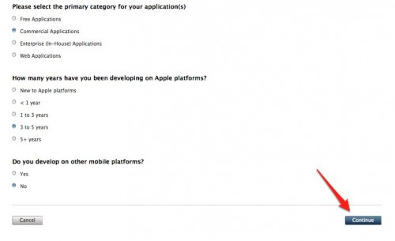
Some more but not much important fill and move

Slide 8
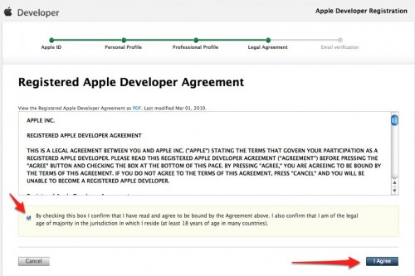
“I Agree”

Slide 9
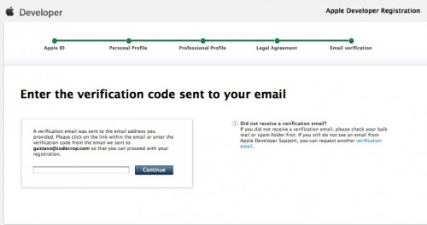
Email Varification

Slide 10
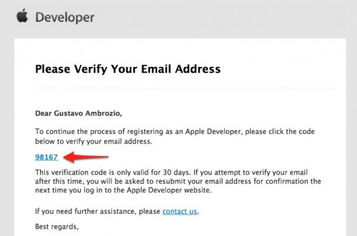
Email Varification cont..

Slide 11
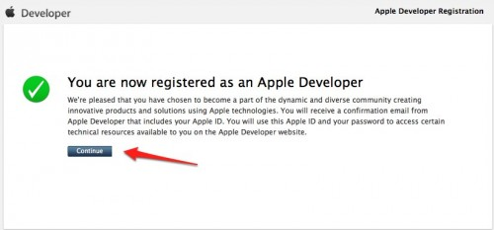
You Are Registered

Slide 12
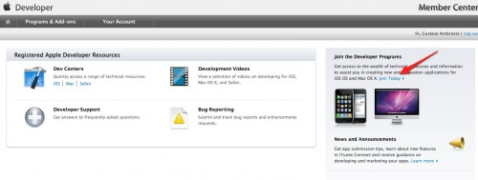
Joining Developer Program

Slide 13
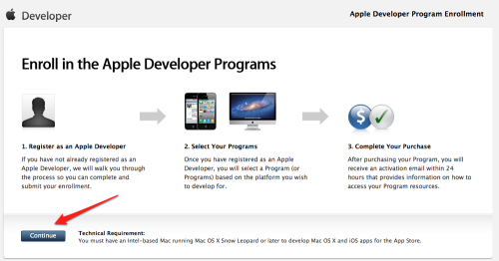
3 steps 15 process

Slide 14
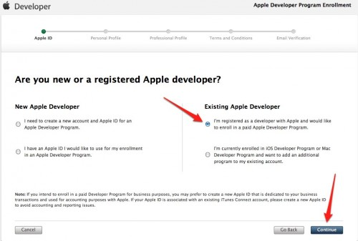
Choose to use your existing Apple Developer ID and click ’Continue’

Slide 15
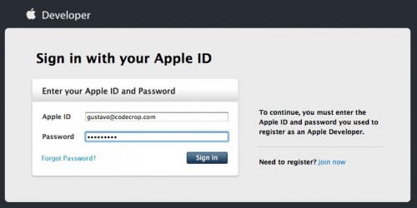
Fill the form and click SignIn

Slide 16
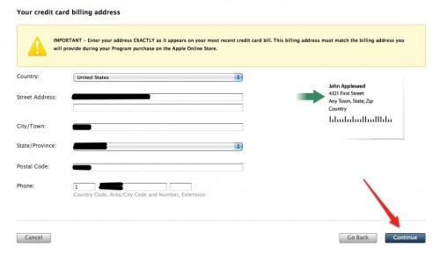
billing information

Slide 17
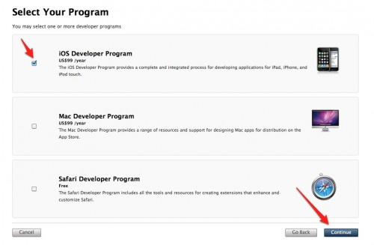
select your programs, To Continue

Slide 18
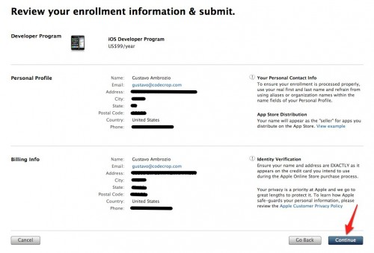
Review your information

Slide 19
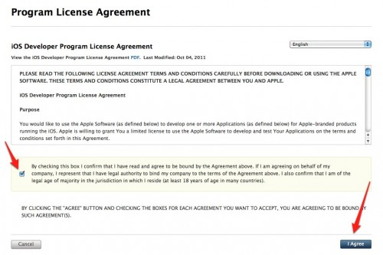
I Agree

Slide 20
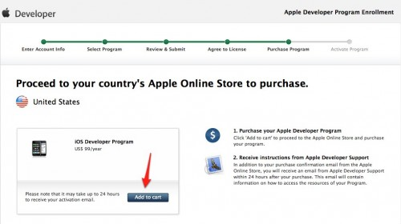
Add to cart

Slide 21
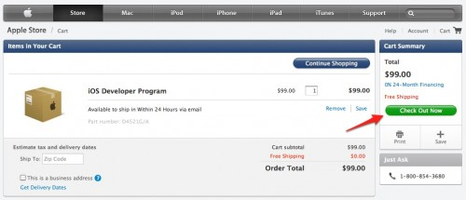
Check Out Now

Slide 22
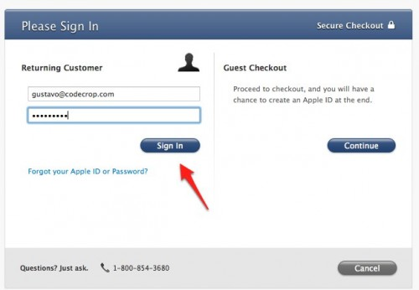
log in again

Slide 23
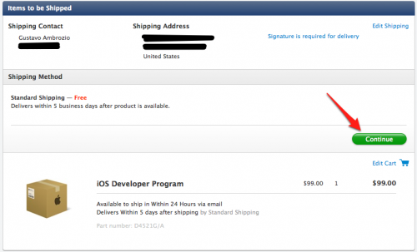
“Continue” again

Slide 24
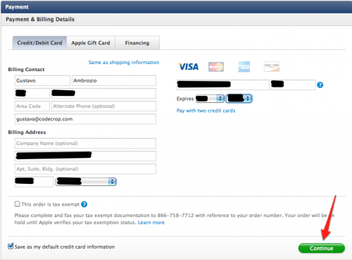
Your Billing Information

Slide 25
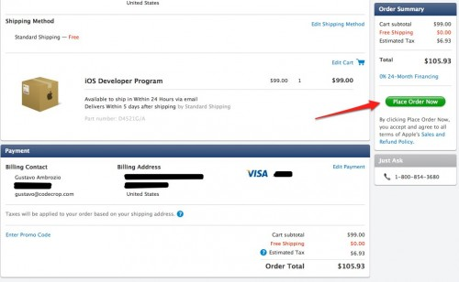
Place Order Now

Slide 26
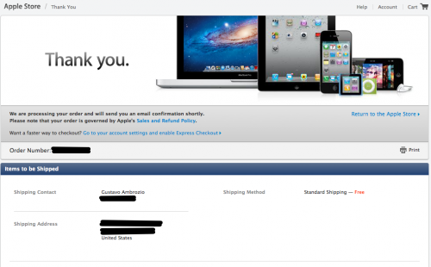
welcome!

Slide 27
Certificate,Device Registrstion And Profiles
Sisoft Technologies Pvt Ltd
SRC E7, Shipra Riviera Bazar, Gyan Khand-3, Indirapuram, Ghaziabad
Website: www.sisoft.in Email:info@sisoft.in
Phone: +91-9999-283-283

Slide 28
Profiles “code signing identities”
Development profiles-
These are tied to specific devices, so the app can only run on those devices
Distribution profiles-
These are used to sign your app before you submit it to Apple for approval. They contain no device-specific information, but you can’t use them to install apps on any device yourself, because Apple still has to sign the app after the approval process

Slide 29
iTunes Connect
iTunes Connect is the portal you’ll use to submit your apps
This is where you’ll register a new app, enter the app’s description and screenshots, choose the price, and configure game center and in-app purchases
This is also the portal you’ll use to agree to new contracts, set your financial data (so you can bank that profit) and check your sales

Slide 30
Lets Start

Slide 31
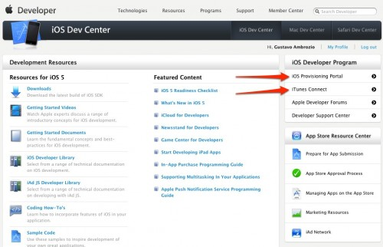
iOS Provisioning Portal and iTunes Connect

Slide 32
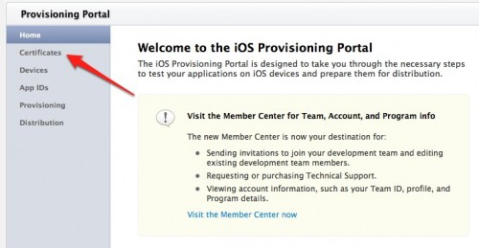
iOS Provisioning Portal

Slide 33
Request Certificate

Slide 34
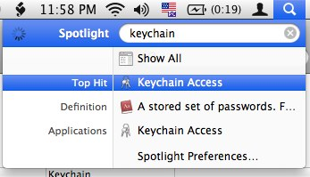
Open The Keychain Access App on your Mac

Slide 35
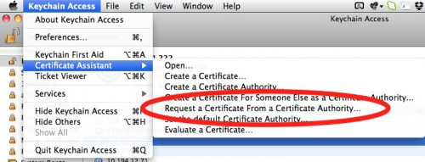
Certificate Assistant--->Request a Certificate From a Certificate Authority…

Slide 36
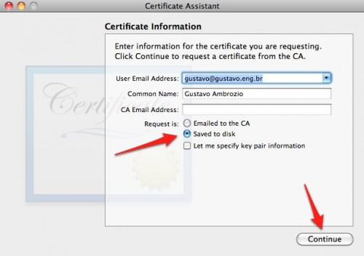
Save to disk

Slide 37
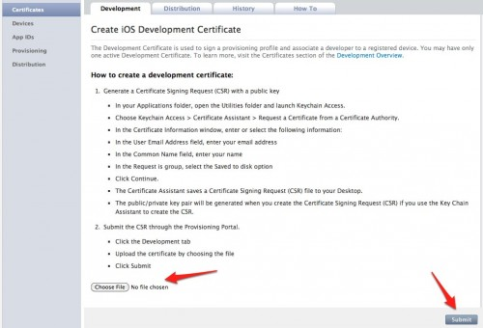
Open Browser, Find This File Using The “Choose File” Button And Click “Submit”

Slide 38
WWDR intermediate certificate (For First Time)

Slide 39
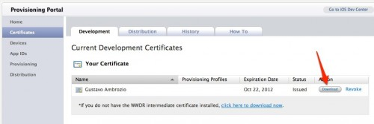
Download

Slide 40
Double-click both files to install them in your keychain(Development And Distribution Profiles)

Slide 41
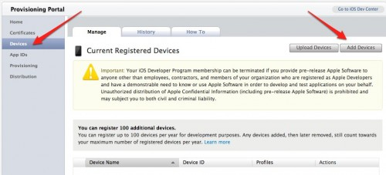
Register Your Devices

Slide 42
Get The UDID
Open iTunes and plug the device
Select the device from the left-side menu
Click on the serial number and it will change to your device’s UDID

Slide 43
Submit Device

Slide 44
Need To Register An App ID

Slide 45
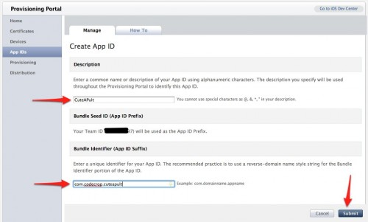
“New App ID”
an app ID is a combination of a 10-character “seed” prefix generated by Apple, and a bundle ID created by you. Together they create a unique identifier for your app

Slide 46
Creat Provisioning Profile

Slide 47
Fill in your app’s info

Slide 48
Download

Slide 49
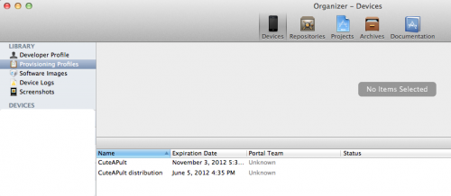
Add In X-code
Double click on downloaded provisining profile to add to x-code

Slide 50
Running App On Devices
Sisoft Technologies Pvt Ltd
SRC E7, Shipra Riviera Bazar, Gyan Khand-3, Indirapuram, Ghaziabad
Website: www.sisoft.in Email:info@sisoft.in
Phone: +91-9999-283-283

Slide 51
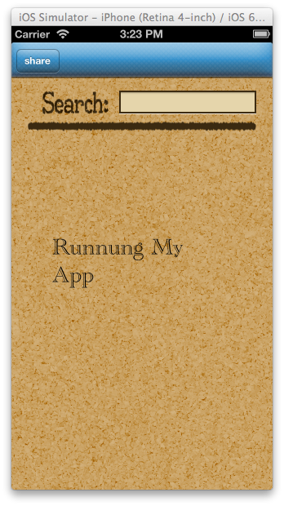
Running App on Device

Slide 52
Connect your device
Once in Xcode, open the Organizer (CMD-SHIFT-2)
Plug in your iOS device and go to the Devices tab
Your screen should look something like snap on next page
Click “Use for Development”

Slide 53
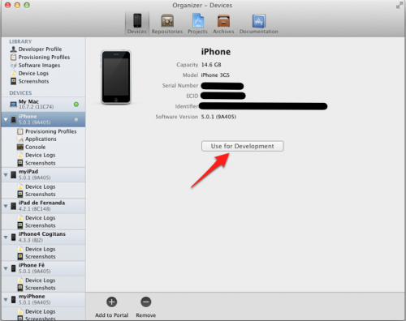

Slide 54
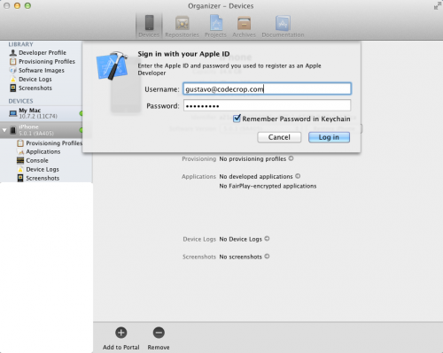
Xcode will ask you for your credentials

Slide 55
Open the project
then click on the target
and fill out the app version and deployment target

Slide 56
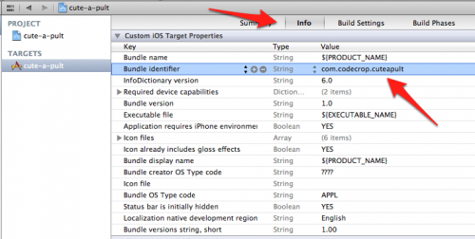
bundle identifier
click the “Info” tab
change the bundle identifier
same bundle identifier you used for the App ID you registered in the Provisioning Portal

Slide 57
Code signing identity
Open build setting>code signing identity
Choose provisining profile with same bundel identifier

Slide 58
You are good to go

